Slide 1



The CATIS logo is an outline of a person sitting at a desk and on the desk is a computer and smart phone with a cane leaning against the desk. In the word CATIS at the top of the logo the letters “AT”, circled by a magnifier, are larger than the other letters. The logo is meant to signify that CATIS serve individuals that are blind and visually impaired. The name is spelled out down the side of the logo.

Slide 2
“CATIS”
A QUICK REVIEW

Slide 3
“CATIS”
Certified Assistive Technology Instructional Specialist
for Individuals who are Blind or have Low Vision
A highly trained expert who specializes in working with individuals who are blind, have low vision or who have functional visual limitations and empowers them to achieve their life goals for education, employment, avocation and independence through the use of assistive technology.

Slide 4
“CATIS”
Must have knowledge in 4 areas:
        Assessment
        Instruction
        Configuration
        Exploration

Slide 5
“CATIS”
Engage in a comprehensive approach to vision rehabilitation addressing visual, physical, cognitive, and psycho-social aspects related to training and integration of existing and emerging technologies. Methods and strategies include the use of visual techniques, non-visual techniques (auditory and tactual), strategies and problem-solving skills through the use of various Assistive Technology devices and solutions

Slide 6
  To be effective in the instruction of Assistive Technology a professional must
  Assess the individuals needs and abilities in order
  to guide in the selection of the appropriate technologies for meeting the individuals goals,
  Understand different learning styles, how that differs based on visual acuity and the most effective teaching techniques for each style

Slide 7
“CATIS”
Are Bound by a Strong
Code of Ethics

Slide 8
“CATIS”
Recertify every 2 years to ensure that they remain current in the field

Slide 9
  When an Employer hires a CATIS they know that they are hiring a vision impairment professional that:
  Represents best practices based on a national standard in providing Assistive Technology assessment and instruction
  Through their knowledge and skill will achieve the best possible outcomes for the clients that the agency serves

Slide 10
“CATIS”
AN UPDATE

Slide 11
  When ACVREP began the development of the CATIS certification there were no university programs providing Master’s or graduate level Certificate programs in ATBVI

Slide 12
  “BUILD IT AND HE WILL COME”
  Movie Quote from Field of Dreams

Slide 13
  There are now 4 University
  Programs for ATBVI

Slide 14
  Master’s and Graduate Certificate Programs:
  Northern Illinois University
  Western Michigan University
  U-Mass Boston
  North Carolina Central University

Slide 15
  In 2016 when the CATIS certification launched Northern Illinois University was awarded a federal grant for a Master’s and a graduate level Certificate program in ATBVI including scholarship funding for students
  They have already graduated 2 cohorts and are currently admitting students

Slide 16
  Western Michigan University is currently admitting their 1st cohort

Slide 17
  U-Mass Boston is expecting to admit
  their 1st cohort in the fall of 2019

Slide 18
  North Carolina Central University is expecting
  to admit their 1st cohort in the fall of 2019

Slide 19
  Additionally, North Carolina University (NCCU)
  is offering an online workshop to assist those currently working in ATBVI who wish to apply
  for CATIS through Category 2 to meet the educational requirements for Assessment, Instruction and ATBVI

Slide 20
  CATIS is going International:
  There are currently 6 applicants from Ireland taking the NCCU workshop in order to qualify for CATIS Eligibility in Category 2
  Discussions have been held with ATBVI personnel in Australia

Slide 21
  182 Applications for Eligibility since CATIS was
  launched mid-year 2016
  127 Have met the Eligibility requirements
  96 CATIS are certified (as of 3-19-19)

Slide 22
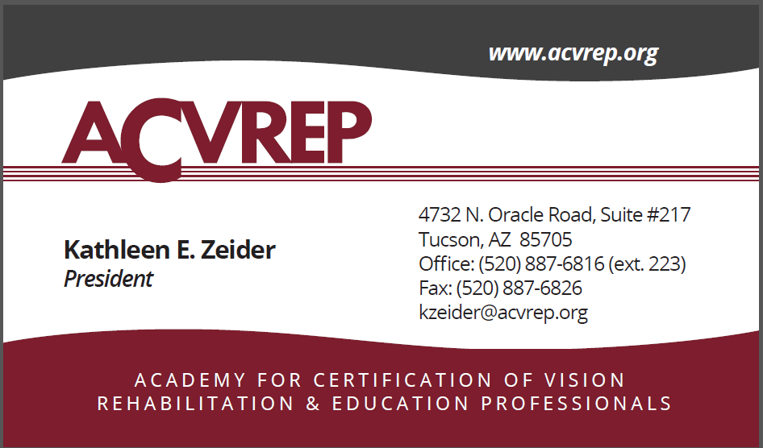
4380 N. Campbell Ave Suite 200
Tucson, Arizona 85718
Office: (520) 887 6816

