Slide 1
Trends in the VR Program
Post-WIOA:
A Shift in Focus and Performance?
CSAVR Spring Conference
April 10, 2019
Fourth General Session
Updates from the
Rehabilitation Services Administration

Slide 2
Presenters
Presiding: Robert Doyle
  State Director, Florida Blind; Past President of CSAVR
Carol Dobak
  Acting Deputy Commissioner, delegated the authority to perform the functions and duties of the Commissioner
Suzanne Mitchell
  Chief, Vocational Rehabilitation Program Unit
RoseAnn Ashby
  Chief, Technical Assistance Unit
David Steele
  Chief, Fiscal Unit
Christopher Pope
  Chief, Data Collection and Analysis Unit
Mary Lovley
  Acting Director, Training and Service Programs Division
Corinne Weidenthal
  Chief, Service Programs Unit

Slide 3
Session Overview
Welcome
Review FFY 2010-2018 and PY 2017-2018 VR Program Data
Review FFY 2010-2018 Fiscal Data
Perspectives on Performance of the VR Program
Updates from RSA’s Training and Service Programs Division
Introduce ReThink Performance
  Steve Wooderson, Chief Executive Officer, CSAVR
  Carol Pankow, President, NCSAB

Slide 4
VR Program Data: FFY 2010-2018
Quarterly Cumulative Caseload Report (RSA-113)
Individuals Entering VR Program and Receiving VR Services
Number of Applicants
Number of Eligible Individuals
Number of Eligible Individuals who Did Not Receive VR Services
  Percent of Total Eligible Individuals

Slide 5
VR Program Data: FFY 2010-2018 and PY 2017-2018
Case Service Report (RSA-911)
Employment Outcomes (FFY 2010-2018)
Employment Rate, Number of Individuals who Exited with Competitive Integrated Employment or Supported Employment, and Median Wages for: All Individuals; Individuals Under Age 25; Individuals Age 25 and Older
FFY 2017 includes the first three quarters of RSA-911 data from PD 14-01 and the first quarter of PY 2017 data from PD 16-04
FFY 2018 includes RSA-911 data from PD 16-04 for the last three quarters of PY 2017 and the first quarter of PY 2018
Pre-Employment Transition Services (PY 2017 and the first two quarters of PY 2018)
Number of Students with Disabilities Reported
Number of Students with Disabilities who Received Pre-Employment Transition Services
Number of Potentially Eligible Students with Disabilities who Received Pre-Employment Transition Services
Number of Students with Disabilities, who applied for VR services, and Received Pre-Employment Transition Services
Percentage of Students with Disabilities Reported who Received Pre-Employment Transition Services

Slide 6
Individuals Applying to VR Program

Slide 7
Individuals Eligible for VR Services

Slide 8
Eligible Individuals Who Received VR Services

Slide 9
Order of Selection (FFY 2010 – FFY 2019)
FFY 2010 | FFY 2011 | FFY 2012 | FFY 2013 | FFY 2014 | FFY 2015 | FFY 2016 | FFY 2017 | FFY 2018 | FFY 2019
35/80 | 37/80 | 36/80 | 36/80 | 34/80 | 36/80 | 35/80 | 37/79 | 40/79 | 41/78
Date | OOS | No OOS | One or more categories closed | All categories closed
February 13, 2018 | 37 | 42 | 21 | 4
September 30, 2018 | 40 | 39 | 27 | 7
March 1, 2019 | 41 | 37 | 33 | 8

Slide 10
All Individuals: Employment Rate

Slide 11
All Individuals: Outcomes

Slide 12
Individuals Under Age 25 vs. Individuals 25 and Older
Employment Outcomes

Slide 13
All Individuals: Median Wages

Slide 14
Individuals Under Age 25 vs. Individuals 25 and Older
Median Wages

Slide 15
Students with Disabilities Reported (by quarter)

Slide 16
Students with Disabilities Reported Who Received
Pre-Employment Transition Services (by quarter)

Slide 17
Number of Students who Applied for VR Services and
Received Pre-Employment Transition Services (by quarter)

Slide 18
Individuals Exiting the VR Program at Various Stages (PY 2017)

Slide 19
Reasons for Exit (PY 2017)
495,593 individuals exited the VR program

Slide 20
State Vocational Rehabilitation (VR) Services Fiscal Data Review
Allocation
Maintenance of Effort Penalties
Reallotment
  Relinquishments
  Trends
Unexpended VR Funds
Non-Federal Share
Program Income
Summary

Slide 21
VR Federal Allocations

Slide 22
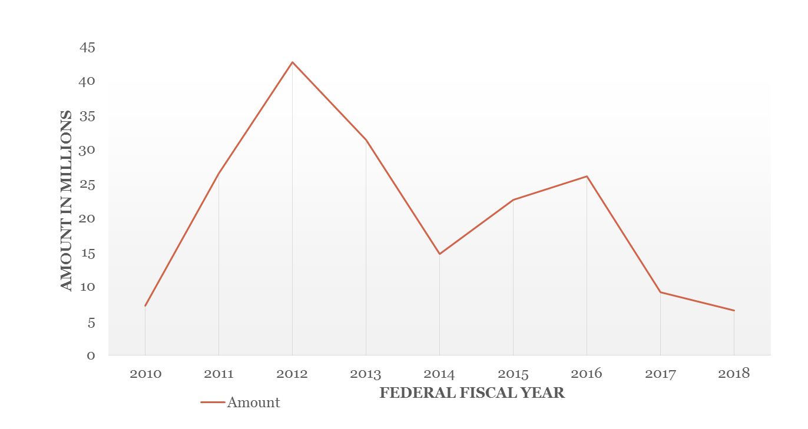
Maintenance of Effort Penalties

Slide 23
Funds Relinquished in Reallotment

Slide 24
Reallotment Trends

Slide 25
VR Funds Unexpended at Closeout

Slide 26
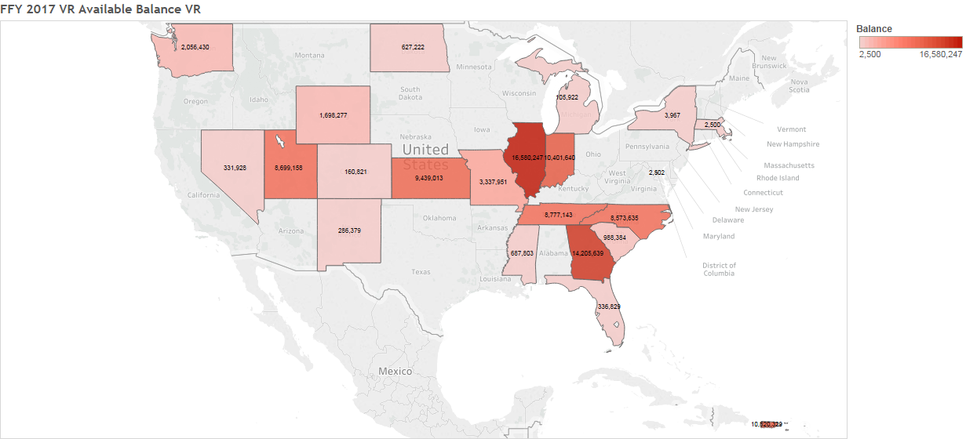
FY 2017 Unexpended VR Funds

Slide 27
VR Non-Federal Share

Slide 28
Federal Program Income

Slide 29
Summary
Since 2015:
Federal allocation to the VR program has increased by approximately $200 million;
Non-Federal VR funds have increased by $49 million;
Program income has decreased by $38 million; and
$281 million in allotted grant award funding was not expended for direct VR purposes.

Slide 30
Training and Service Programs Division Updates
TSPD
Personnel Update
ReThink Training Programs and Service Programs

Slide 31
Training and Service Programs Division Updates
Training Programs Unit
Rehabilitation Long-Term Training program
Technical Assistance Centers
  WINTAC
  VRTAC-Y
  VRTAC-TC
  PEQA

Slide 32
Training and Service Programs Division Updates
Service Programs Unit
American Indian Vocational Rehabilitation Services Program (AIVRS)
  Upcoming Events
Randolph-Sheppard Vending Facility Program
  New RSA Staff
PROMISE
  Upcoming Events

Slide 33
OSERS
Improve early childhood, educational, and employment outcomes and raise expectations for
all people with disabilities, their families, their communities, and the nation.
RETHINK
OSERS will rethink anything and everything to ensure that we are in the best position to
achieve our mission.
• Address deeply embedded and complex issues
• Question systems that do not facilitate the kind of improvement we know is necessary
• Confront structures that limit opportunities for individuals with disabilities
• Change policies and practices that put the needs of a system over the needs of the individual
• Challenge mindsets that appear intent on preserving the status quo
Office of Special Education and Rehabilitative Services
U.S. Department of Education
Notes:
OSERS is a mission-driven organization
The mission of OSERS is to:
Improve early childhood, educational, and employment outcomes and raise expectations for all people with disabilities, their families, their communities, and the nation.
The framework prioritizes rethinking all aspects of how we better service students, infants, toddlers, children, youth and adults with disabilities.
“Rethink whatever we need to rethink, question whatever we need to question to make sure we are in the best position to deliver on the OSERS’ mission.”
Rethink systems/structures, policies and practices, embedded/complex issues, and mindsets, including our own, in an effort to achieve goals
Rethink and question anything and everything in order to:
Ensure that we are in the best position to achieve our mission
Address and challenge status quo
Be better positioned to help individuals with disabilities
Ensure nothing limits any individual from being prepared for their next right steps

Slide 34
ReThink Performance
In partnership, RSA, CSAVR, NCSAB, and VR agencies are committed to rethinking the way we look at the performance of the VR program, improving results, and maintaining high expectations of both the VR program and individuals with disabilities.
Using data in our decision making, we will identify strategies that RSA and VR agencies may adopt to foster continuous improvement, collaboration, and maximize high-quality employment opportunities for customers served by the VR program.

Slide 35
ReThink Performance
CSAVR: Steve Wooderson
NCSAB: Carol Pankow (Minnesota-Blind)
Confirmed VR Agencies:
  Combined: Arizona, Maryland, Tennessee, and Texas
  General: Arkansas and Iowa
  Blind: Michigan and Oregon
WINTAC
RSA
June 3-4 and August 5-6, 2019
Washington, DC

Slide 36

Thank You

