Slide 1
Data Validation:
Yes, Data Does Matter to All of Us
NCSAB Spring Conference 2019

Slide 2
Presenters
Natasha Jerde
Minnesota State Services for the Blind
Rachel Anderson
Workforce Innovation Technical Assistance Center (WINTAC)
Christopher Pope
Rehabilitation Services Administration (RSA)

Slide 3
Objectives
Understand the background and intent of the joint Data Validation Guidelines (RSA TAC 19-01, issued December 19, 2018) and the importance of source documentation.
Review practices and examples related to VR program source documentation and recommendations for creating successful data validation policies and procedures.
Learn from Minnesota State Services for the Blind, and other VR Agencies, about their policies and procedures for data validation.

Slide 4
Overview
Joint Data Validation Guidance
  WIOA section 116(d)(5) requires the States to establish procedures, consistent with guidelines issued by the Departments, to ensure that the data reported is valid and reliable.
  These guidelines were developed jointly between the U.S. Departments of Education and Labor:
    Employment and Training Administration (ETA)
    Office of Career, Technical, and Adult Education (OCTAE)
    Rehabilitation Services Administration (RSA)

Slide 5
Background
Prior to WIOA, ETA, OCTAE and RSA had separate mechanisms for ensuring data reported by State agencies was valid and reliable.
Clarification about this guidance:
  There was no specific statistical validation methodology provided by Federal agencies. (No performance report, as in the past, for DOL programs; however, reports on aspects of processes or about other issues may be required.)
  There was no specific data validation software identified or required.
  This guidance sets parameters for ensuring data quality consistent with the Departments’ guidelines to assist State agencies to develop their own data validation procedures as required by section 116(d)(5) of WIOA.

Slide 6
What is the Purpose of Data Validation?
To verify that the performance data reported by States to the Departments are valid, accurate, reliable and comparable across programs;
To identify anomalies in the data and resolve issues that may cause inaccurate reporting;
To outline source documentation required for common data elements; and
To improve program performance accountability through the results of data validation efforts.

Slide 7
What must Data Validation
Procedures include?
Written procedures for data validation that contain a description of the process for identifying and correcting errors or missing data, which may include electronic data checks.
Regular data validation training for appropriate program staff (e.g., at least annually).
Monitoring protocols to ensure that program staff are following the written data validation procedures and taking appropriate corrective action if those procedures are not being followed.

Slide 8
What must Data Validation
Procedures include? (continued)
A regular review of program data (e.g., quarterly) for errors, missing data, out-of-range values and anomalies.
Documentation that missing and erroneous data identified during the review process have been corrected.
Regular assessment of the effectiveness of the data validation process (e.g., at least annually) and revisions to that process as needed.

Slide 9
Required and Optional
Data Validation
States must include regular data element validation through core program monitoring on 24 Joint Participant Individual Record Layout (PIRL) elements.
22 of these Joint PILR elements pertain to the VR program and correspond to 33 Data Elements (DE) on both the current and proposed versions of the Case Service Report (RSA-911).
States may:
  Maintain supporting documentation for program-specific data elements not included in this joint guidance.
  Conduct additional source document validation on more data elements.
  Require additional source documentation in their procedures.

Slide 10
Which Common Data Elements
Require Source Documentation?
Date of Program Entry
Date of Program Exit
Other Reasons for Exit
Type of Training Service #1
Type of Training Service #2
Type of Training Service #3
Participated in Postsecondary Education During Program Participation
Enrolled in Secondary Education Program
Date Enrolled in Post Exit Education or Training Program Leading to a Recognized Postsecondary Credential
Employed in 1st Quarter After Exit Quarter
Employed in 2nd Quarter After Exit Quarter
Employed in 3rd Quarter After Exit Quarter
Employed in 4th Quarter After Exit Quarter

Slide 11
Which Common Data Elements Require
Source Documentation? (continued)
Wages 2nd Quarter After Exit Quarter
Type of Recognized Credential
Date Attained Recognized Credential
Date of Most Recent Measurable Skill Gains: Educational Functioning Level (EFL)
Date of Most Recent Measurable Skill Gains: Postsecondary Transcript/Report Card
Date of Most Recent Measurable Skill Gains: Secondary Transcript/Report Card
Date of Most Recent Measurable Skill Gains: Training Milestone
Date of Most Recent Measurable Skill Gains: Skills Progression
Date Enrolled During Program Participation in an Education or Training Program Leading to a Recognized Postsecondary Credential or Employment
Youth 2nd Quarter Placement (Title I) – does not apply to VR
Youth 4th Quarter Placement (Title I) – does not apply to VR

Slide 12
Which RSA-911 Data Elements Require
Source Documentation? (1 of 4)
Date of Program Entry
  DE 127 (Start Date of Initial VR Service on or After IPE)
Date of Program Exit
  DE 353 (Date of Exit)
Other Reasons for Exit
  DE 355 (Reason for Program Exit)
Type of Training Service #1, #2, #3:
  DE 150 (Occupational or Vocational Training, Service Provided by VR Agency Staff (in-house))
  DE 151 (Occupational or Vocational Training, Service Provided Through VR Agency Purchase)
  DE 155 (Occupational or Vocational Training, Service Provided by Comparable Services and Benefits Providers)
  DE 164 (Registered Apprenticeship Training, Service Provided Through VR Agency Purchase)
  DE 168 (Registered Apprenticeship Training, Service Provided by Comparable Services and Benefits Providers)
  DE 198 (Randolph-Sheppard Entrepreneurial Training, Service Provided by VR Agency Staff (in-house))
  DE 199 (Randolph-Sheppard Entrepreneurial Training, Service Provided Through VR Agency Purchase)
  DE 204 (Randolph-Sheppard Entrepreneurial Training, Comparable Services and Benefits Provider Type)

Slide 13
Which RSA-911 Data Elements Require
Source Documentation? (2 of 4)
Participated in Postsecondary Education During Program Participation
  DE 84 (Enrolled in Postsecondary Education or career or technical training)
Enrolled in Secondary Education Program
  DE 78 (Enrolled in Secondary Education)
Date Enrolled in Post Exit Education or Training Program Leading to a Recognized Postsecondary Credential
  DE 376 (Date Enrolled in Post-Exit Education or Training Program Leading to a Recognized Postsecondary Credential)
Employed in 1st Quarter After Exit Quarter
  DE 379 (Employment - First Quarter After Exit Quarter)
Employed in 2nd Quarter After Exit Quarter
  DE 383 (Employment - Second Quarter After Exit Quarter)
Employed in 3rd Quarter After Exit Quarter
  DE 386 (Employment - Third Quarter After Exit Quarter)

Slide 14
Which RSA-911 Data Elements Require
Source Documentation? (3 of 4)
Employed in 4th Quarter After Exit Quarter
  DE 389 (Employment - Fourth Quarter After Exit Quarter)
Wages 2nd Quarter After Exit Quarter
  DE 385 (Quarterly Wages - Second Quarter After Exit Quarter)
Type of Recognized Credential
  DE 378 (Type of Recognized Credential Attained Post-Exit)
  This is listed as N/A for the RSA-911 in TAC 19-01 because the supporting documentation is required for DEs below, for Date Attained Recognized Credential
Date Attained Recognized Credential
  DE 87 (Date Attained Associate Degree)
  DE 88 (Date Attained Bachelor's Degree)
  DE 89 (Date Attained Master’s Degree)
  DE 90 (Date Attained Graduate Degree)
  DE 93 (Date Attained Vocational/Technical License)
  DE 94 (Date Attained Vocational/Technical Certificate or Certification)
  DE 95 (Date Attained Other Recognized Credential)

Slide 15
Which RSA-911 Data Elements Require
Source Documentation? (4 of 4)
Date of Most Recent MSG: Educational Functioning Level (EFL)
  DE 343 (Measurable Skill Gain: Educational Functional Level (EFL))
Date of Most Recent MSG: Postsecondary Transcript/Report Card
  DE 345 (Measurable Skill Gain: Postsecondary Transcript/Report Card)
Date of Most Recent MSG: Secondary Transcript/Report Card
  DE 344 (Measurable Skill Gain: Secondary)
Date of Most Recent MSG: Training Milestone
  DE 346 (Measurable Skill Gain: Training Milestone)
Date of Most Recent MSG: Skills Progression
  DE 347 (Measurable Skill Gain: Skills Progression)
Date Enrolled During Program Participation in an Education or Training Program Leading to a Recognized Postsecondary Credential or Employment
  DE 85 (Date Enrolled During Program Participation in an Education or Training Program Leading to a Recognized Postsecondary Credential or Employment)

Slide 16
What Other VR Program Data Elements
Require Source Documentation?
DE 7 (Date of Application)
DE 38 (Date of Eligibility Determination)
DE 48 (Date of IPE)
DE 350 (Start Date of Employment in Primary Occupation)
DE 356 (Employment Outcome at Exit)
DE 359 (Hourly Wage at Exit)
DE 354 (Type of Exit)
DE 535 (Date of Exit)

Slide 17
Source Documentation Examples

Slide 18
Examples of Source Documentation
Copy of Credential
Transcript or Report Card
Data Match (Employment/UI)
Paycheck stubs
Quarterly Tax/IRS Forms
Results from Exam
Copy of Credential only earned after the passage of an exam
OJT
Registered Apprenticeship
Contract or evaluation from employer or training provider
Documentation from Employer on company letterhead
Vendor training documentation

Slide 19
Case Notes and File Documentation
Examples
Cannot get paystubs or employment letter from the participant or employer
Cannot get verification of the enrollment date of a recognized education program
Documentation verifying employment/wages by the employer (not the participant)
Considerations
Should be used when all other options were exhausted, not the agency’s main policy or strategy (efforts should be documented)
Include justification for not providing formal documentation
Be mindful of where this option is and is not allowable
Provide training and guidance to staff as to what must be included in the case notes and file documentation

Slide 20
Unemployment Insurance (UI)
Examples
Considerations
Employment verification 2nd Quarter after Exit Indicator
Employment verification 4th Quarter after Exit Indicator
Total quarterly earnings for Median Earnings 2nd Quarter after Exit Indicator
Weekly Earnings at Employment
UI provides data in a variety of ways; be sure data is available in the format allowable for the data element.
For weekly earnings at employment, the UI data would need to show hourly wages; however, aggregate UI data is allowable for performance elements.
Be aware of the time lag in data. Will the data actually provide you the source documentation needed within the allowable timeframe?

Slide 21
Data Match with Education System
Examples
Considerations
Enrollment in a postsecondary or secondary education program (Credential Attainment Indicator)
Date Attained Recognized Credential (Credential Attainment Indicator)
Postsecondary training enrollment for Educational Functioning Level (EFL) (Measurable Skill Gains Indicator)
Be aware of the time lag in data; will the data actually provide you the source documentation needed within the allowable timeframe?
Is there a cost per record match?
Where will this information live? (e.g., VR case management system, aggregate administrative record, education agency)

Slide 22
Follow-Up Survey and Self-Attestation
Examples
Considerations
Self-Employment Worksheets (created by core program)
Supplemental wage and credential information for post-exit verification
Must be completed and signed by participant, not program staff
Must be sent out electronically or by mail for participant to complete
Agency policies must include procedures related to supplemental wage information, forms and requirements

Slide 23
General Considerations for Source Documentation
An agency may provide multiple sources to show proof of the data element, which increases data validity.
  For example: ‘Type of closure’ and ‘Reason for Exit’ may be documented by a closure letter, counselor case notes describing the reason for closure, and employment or wage documentation.
Follow joint guidance while also using common sense decision-making regarding appropriate data validation.
  For example: If a participant successfully exits the VR program with employment, but the counselor has been unable to verify employment via the participant, the employer, UI or job coach forms, is a case note by the counselor sufficient?
Source documentation is only as good as its content.
  For example: Documenting an MSG through postsecondary transcripts is an allowable option; however, the transcripts must verify sufficient academic progress outlined in joint guidance and agency policy.

Slide 24
Minnesota State Services for the Blind
Data Validation Practices

Slide 25
Minnesota Blind Data Validation:
Federal Reporting
RSA-911 Implementation Procedure
  Errors and Anomalies Tracking
  Query Validation: Record Number Match and Exit Information
  Random sampling
SF-425 Implementation Procedure
  Specific queries and reports have been developed to catch missing/outstanding payments and incorrectly coded expenditures
  Pre-ETS Allowable Costs Report
RSA-2 Implementation Procedure
  RSA-2 process is completed monthly by Fiscal Coordinator to highlight any fiscal inaccuracies, incorrect expenditures, and other errors and anomalies
  RSA-2 aligns with SF-425

Slide 26
Minnesota Blind Data Validation:
Case Review and Quality Assurance
Take a Breath Week
Case review process
  Bi-Monthly Targeted Reviews (Includes a Topic Du Jour)
  Quarterly Intensive Reviews
Prior review and approval
  Eligibilities and Priority for Services
  Case Closures

Slide 27
Minnesota Blind Data Validation:
Tools for Field Staff
Pre-Exit Checklist
Case Documentation and Record of Service Policy
  Data fix process
Missing Documents Report
Pre-ETS Expenditure Report
Social Security Number Matching and Validation Report

Slide 28
Data Validation: Federal and State Oversight

Slide 29
Data Validation: Federal Review
ETA, RSA and OCTAE will review data validation procedures of State agencies, in accordance with established procedures.
Federal reviews may include the following:
  Review of state agency policies, procedures, protocols, training and their deployment.
  Review of reporting and validation process, including state data systems.
  Review of the state agency’s data validation methodology.

Slide 30
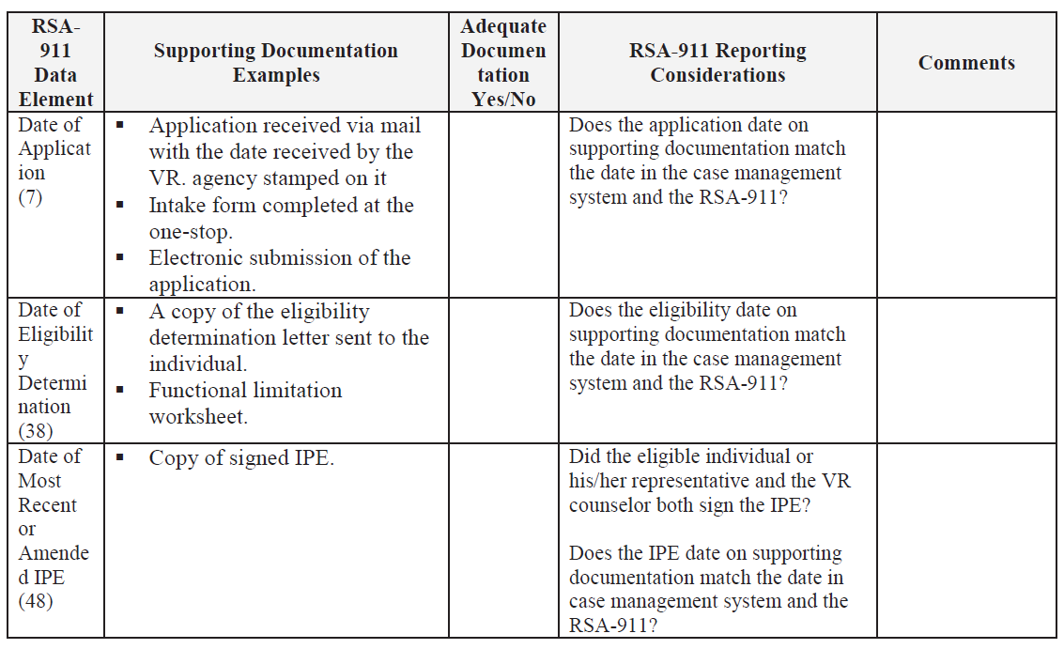
Examples: FY 19 Monitoring
Service Record Review Instrument

Slide 31
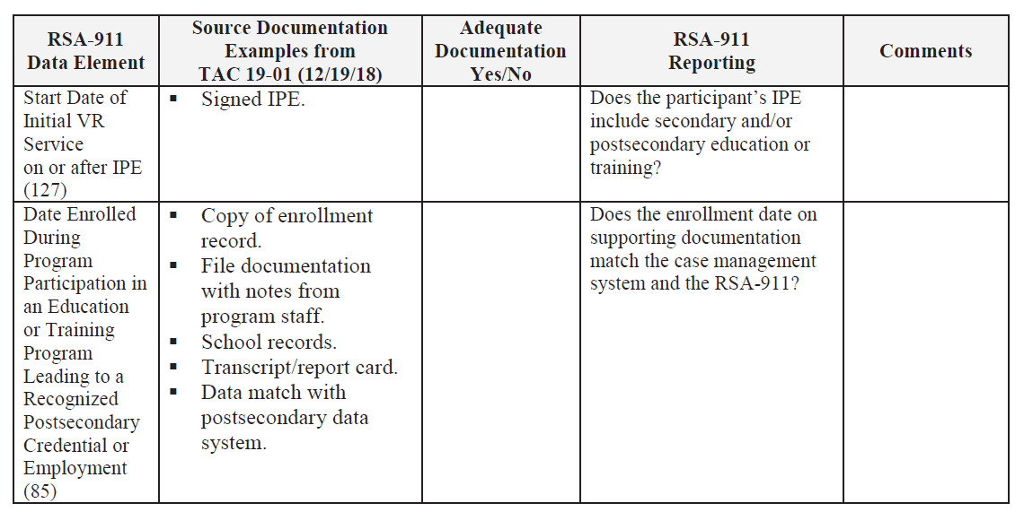
Examples: FY 19 Monitoring
Service Record Review Instrument: MSG

Slide 32
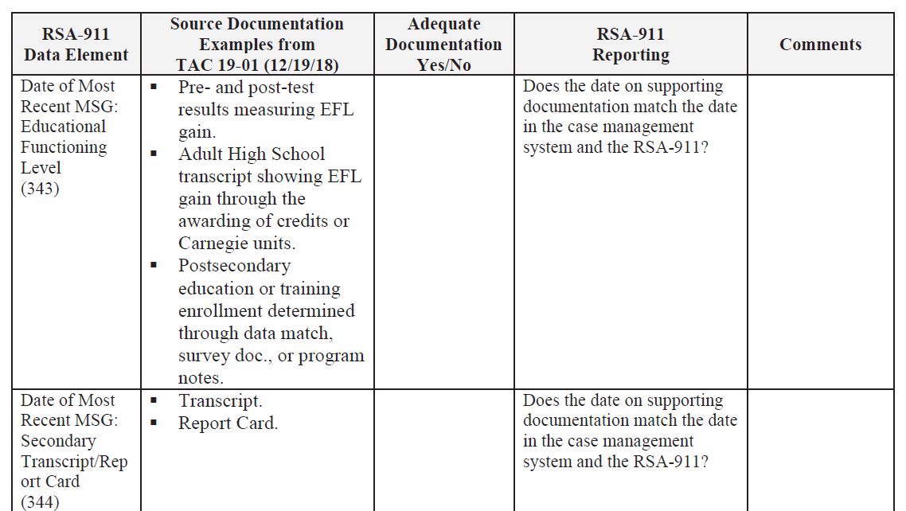
Examples: FY 19 Monitoring
Service Record Review Instrument: MSG (cont.)

Slide 33
Data Validation: State Review
States should implement procedures for reviewing, validating and correcting source documentation practices.
State reviews may include the following:
  Annual review of state agency policies, procedures, protocols, training and their deployment
  Annual review of reporting and validation process, including state data systems
  Annual review of the state agency’s data validation methodology
  Quarterly and targeted reviews for areas identified as high risk

Slide 34
VR Agency Sharing and Discussion
Does your State/agency have written procedures for data validation and conduct regular data validation training for appropriate program staff?
What are your State agency’s monitoring protocols to ensure that program staff are following the written data validation procedures?
How do you regularly assess the effectiveness of your State agency’s data validation process?

Slide 35
For More Sharing and Discussion
On February 6, 2019, ETA, OCTAE and RSA delivered a joint webinar to roll out the Data Validation Guidelines.
To view the archived webinar, please visit
https://ion.workforcegps.org/resources/2019/01/15/21/29/WIOA-Joint-Data-Validation-Overview

Slide 36
Resources
RSA TAC 19-01: Guidance for Validating Jointly Required Performance Data Submitted under the Workforce Innovation and Opportunity Act (WIOA)
Guidelines: Supporting Documentation for Case Service Report (RSA-911), March 31, 2017
RSA TAC 17-04: Guidance on the Use of Supplemental Wage Information to Implement the Performance Accountability Requirements under the Workforce Innovation and Opportunity Act

Slide 37


Contact
Rachel Anderson randerson@ndi-inc.org
(435) 764-8487
www.wintac.org
RSA’s Data Collection and Analysis Unit
RSAdata@ed.gov

