Slide 1
And the Data Says…
Proactive Methods for Using Data
To Track and Improve VR Outcomes
NCSAB Fall Conference
Long Beach, CA
October 31, 2018

Slide 2
Objectives
Identify current trends in PY17 National RSA-911 Data for Blind Agencies.
Discuss the WIOA Performance Measures, VR Program-specific requirements and moving beyond compliance.
Review internal control and data, analyzing recommendations from RSA and WINTAC.

Slide 3
WIOA Performance Outcomes and
VR Program Outcomes

Slide 4
WIOA: Performance Measures
Common Performance Measures apply across all six core programs:
      Employment Rate 2nd Quarter after Exit
      Employment Rate 4th Quarter after Exit
      Median Earnings in the 2nd Quarter after Exit
      Credential Attainment Rate
      Measurable Skill Gains
      Effectiveness in Serving Employers

Slide 5
Additional VR Program Measures
In addition to WIOA Performance Measures, there are a variety of ways to measure VR program success and improvement needs:
  Employment Rates
  Engagement – Early and Often
  Early Exiter Data
  Client Satisfaction
  Partner Collaboration and Satisfaction
  Evaluating effectiveness of vendor (i.e. CRP’s) services
  Timely services – Eligibility to IPE, etc.
  IPE Goal vs. Exit Occupation
  Quality – Career Path vs. Entry Level Job
  Recidivism – Reason for returning participants
  Other

Slide 6
PY2017 Data for Agencies Serving Blind and Visually Impaired Individuals
NSCAB Conference
Long Beach, CA
October 31, 2018

Slide 7
Demographic Information

Slide 8
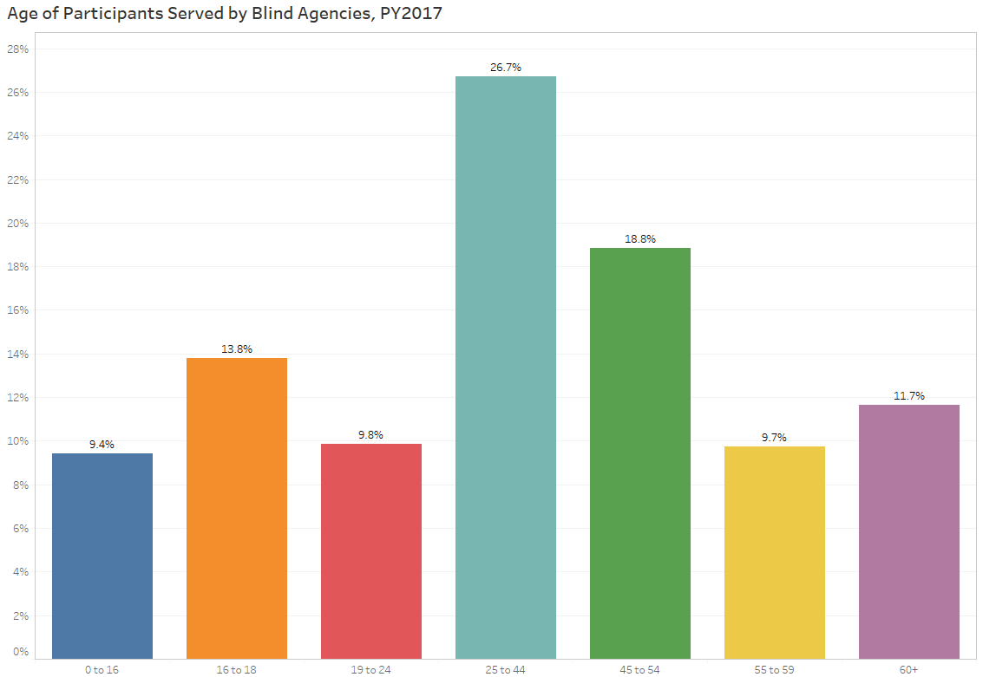
Age

Slide 9
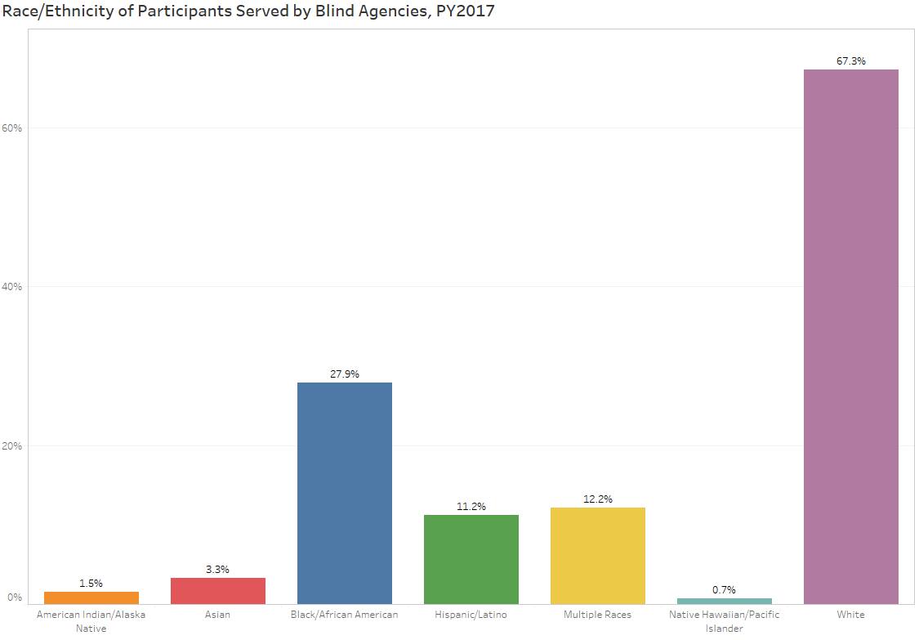
Race/Ethnicity

Slide 10
Gender

Slide 11
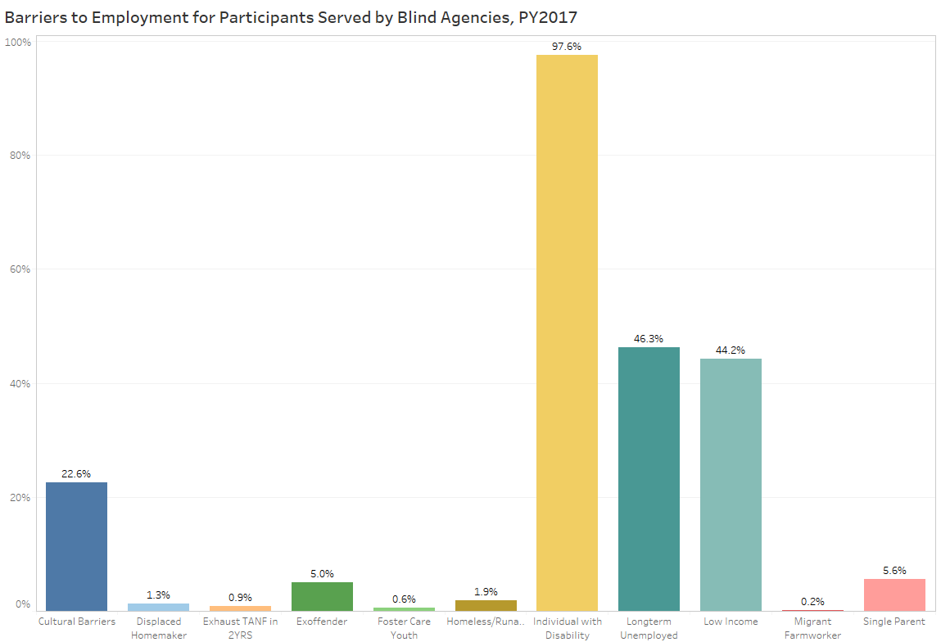
Barriers to Employment

Slide 12
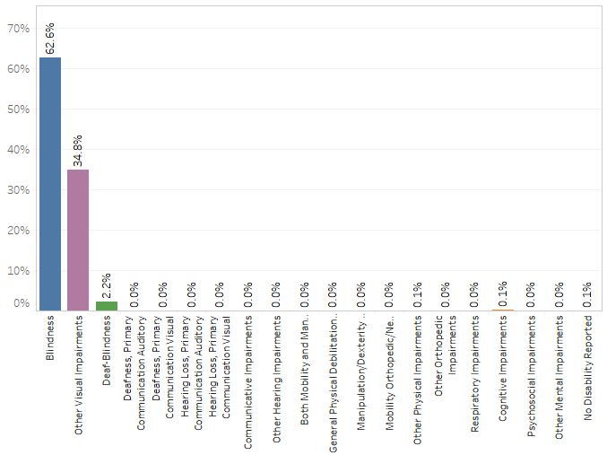
Primary Disability Type

Slide 13
Career & Training Services

Slide 14
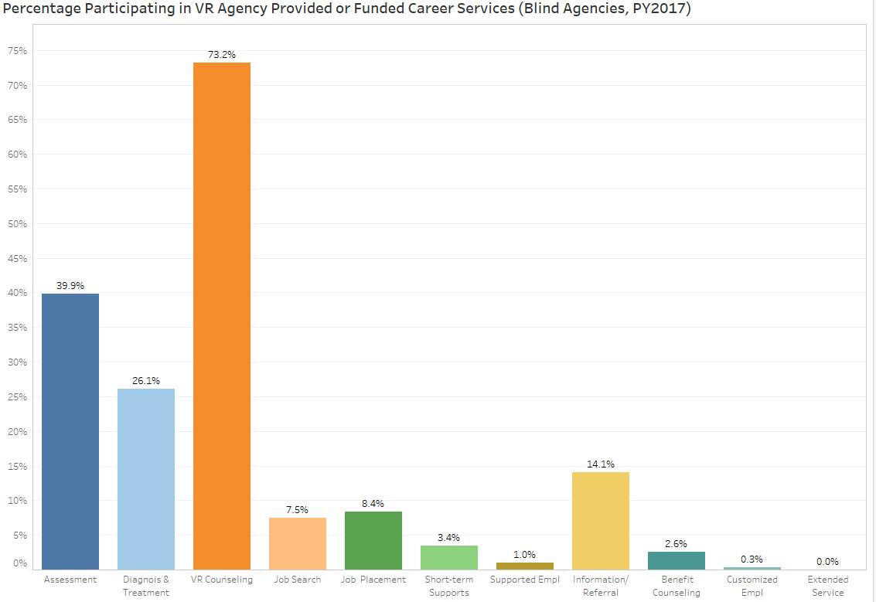
Career Services
87.0% of participants received a career service

Slide 15
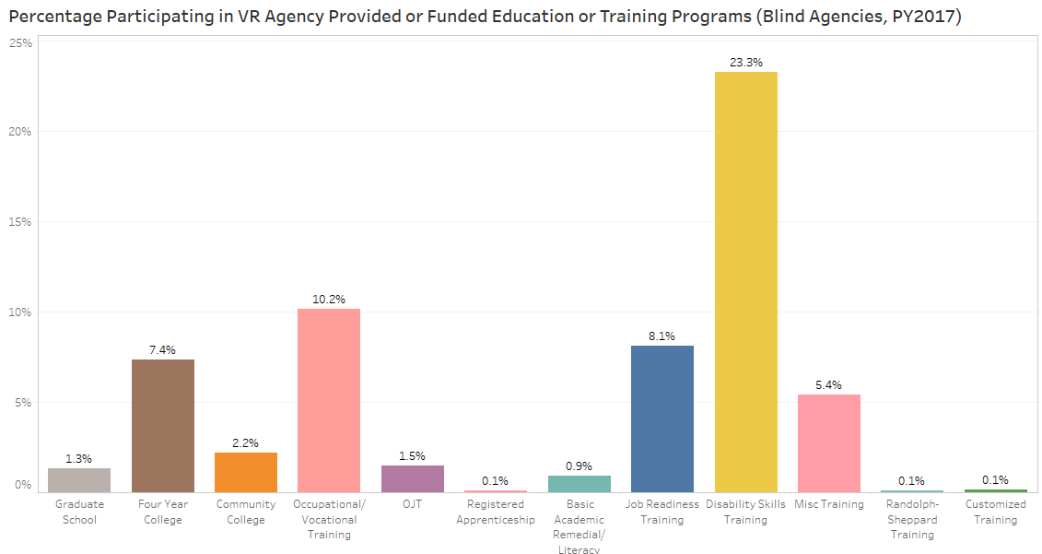
Education and Training Services
43.9% of participants received an education or training service

Slide 16
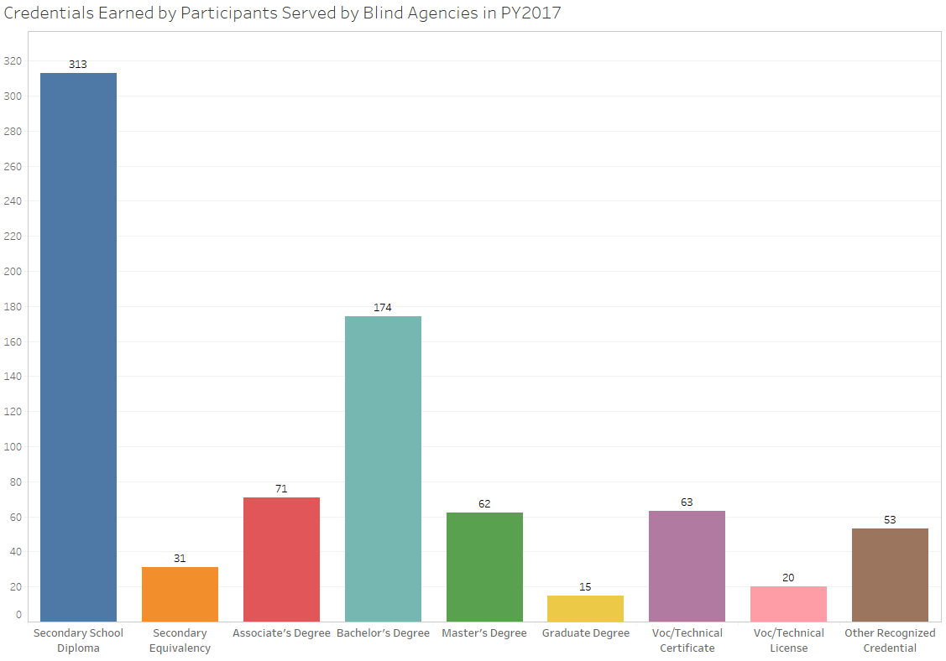
Credential Attainment
Participants earning a secondary diploma or equivalent must be employed or enrolled in a post-secondary education or training program leading to a credential within one year of exit

Slide 17
Measureable Skill Gains

Slide 18
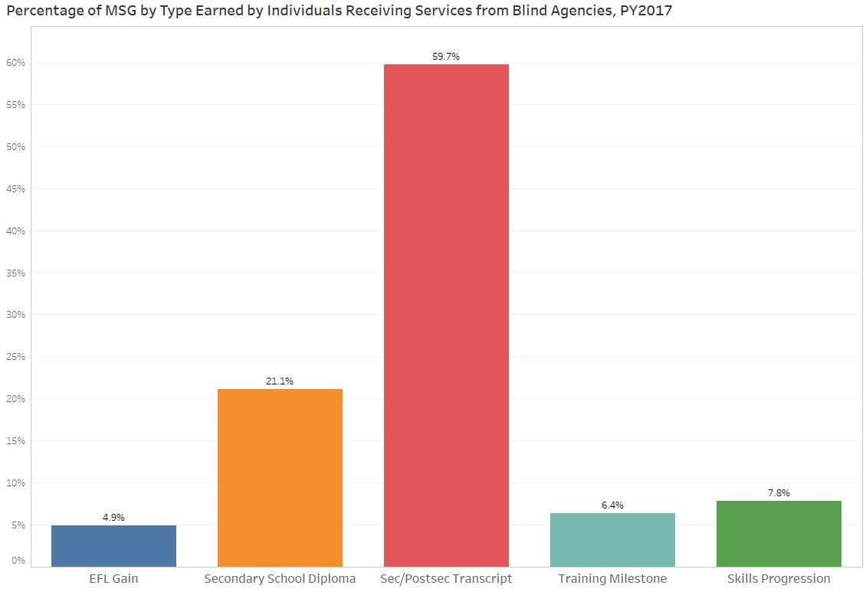
Measurable Skill Gains
1,418 MSG were earned in PY2017

Slide 19
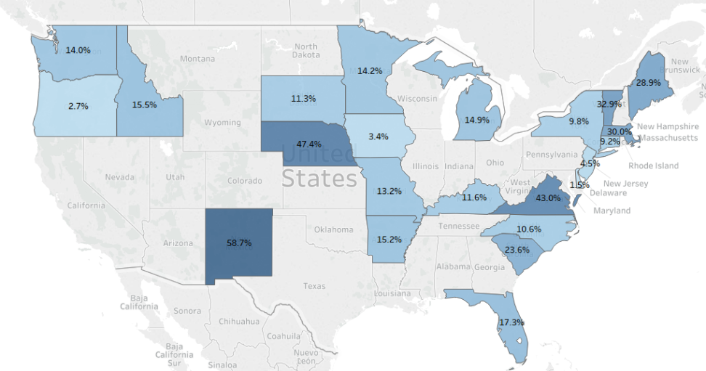
Eligible for MSG
16.1% of participants who received services from blind agencies were eligible for the MSG indicator

Slide 20
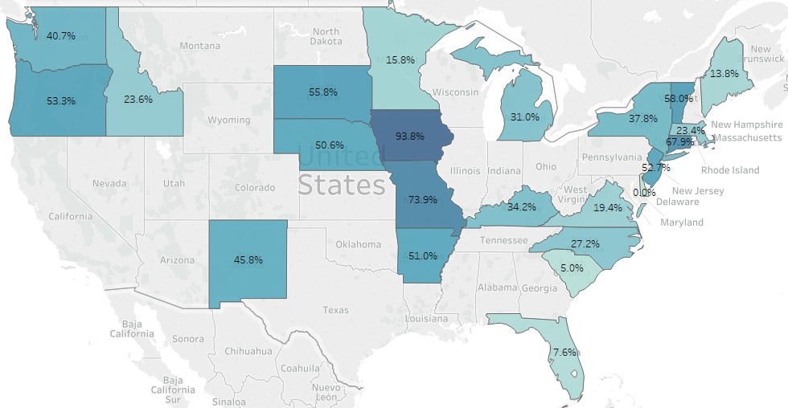
Measureable Skill Gains Rate
30.4% of participants receiving services from blind agencies earned a Measureable Skill Gain in PY2017

Slide 21
Exiter Information

Slide 22
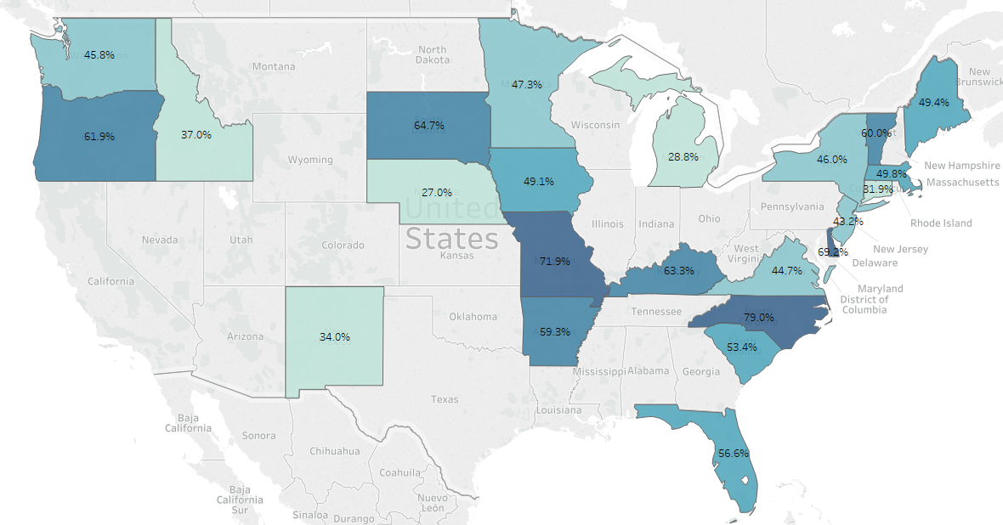
Employment Rate
Employment Rate
In PY2017, the employment rate for individuals receiving services from blind agencies was 52.3%

Slide 23
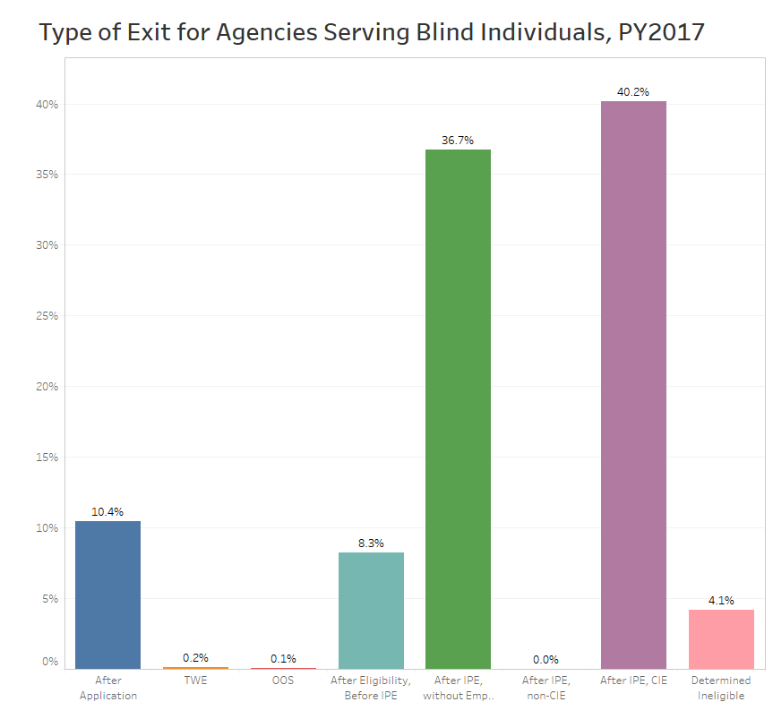
Type of Exit

Slide 24
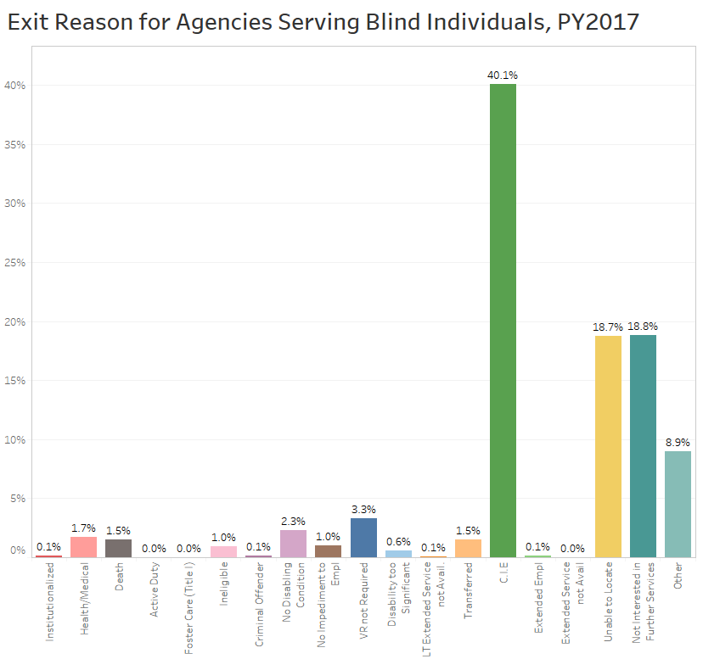
Reason for Exit

Slide 25
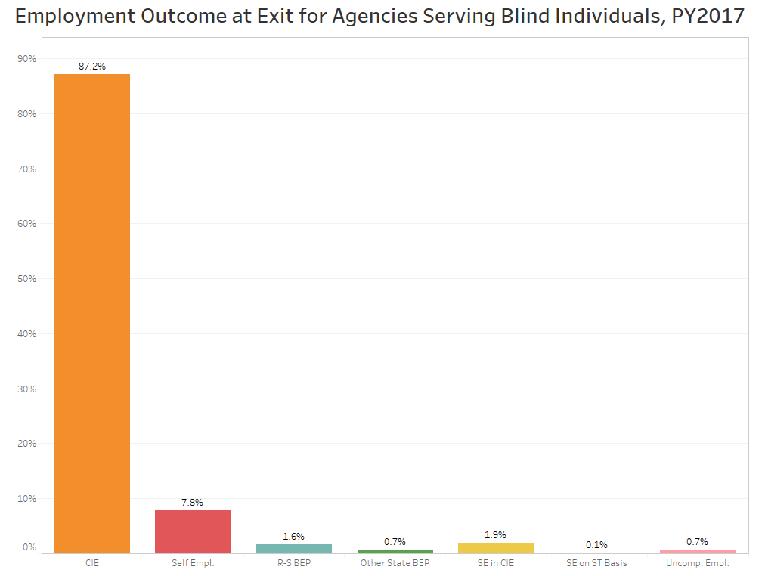
Employment Outcome

Slide 26
Quality of Outcomes

Slide 27
Quality of Employment
Median Hourly Wage at Exit, PY2017: $12.89
Median Hours Worked at Exit, PY2017: 35/week

Slide 28
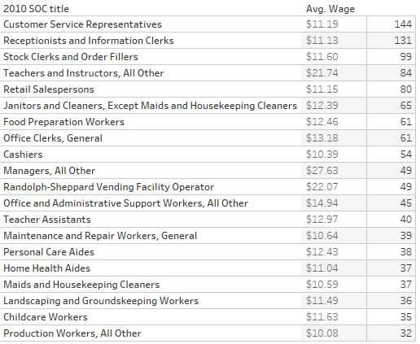
Employment by Occupation for Individuals Served by Blind Agencies

Slide 29
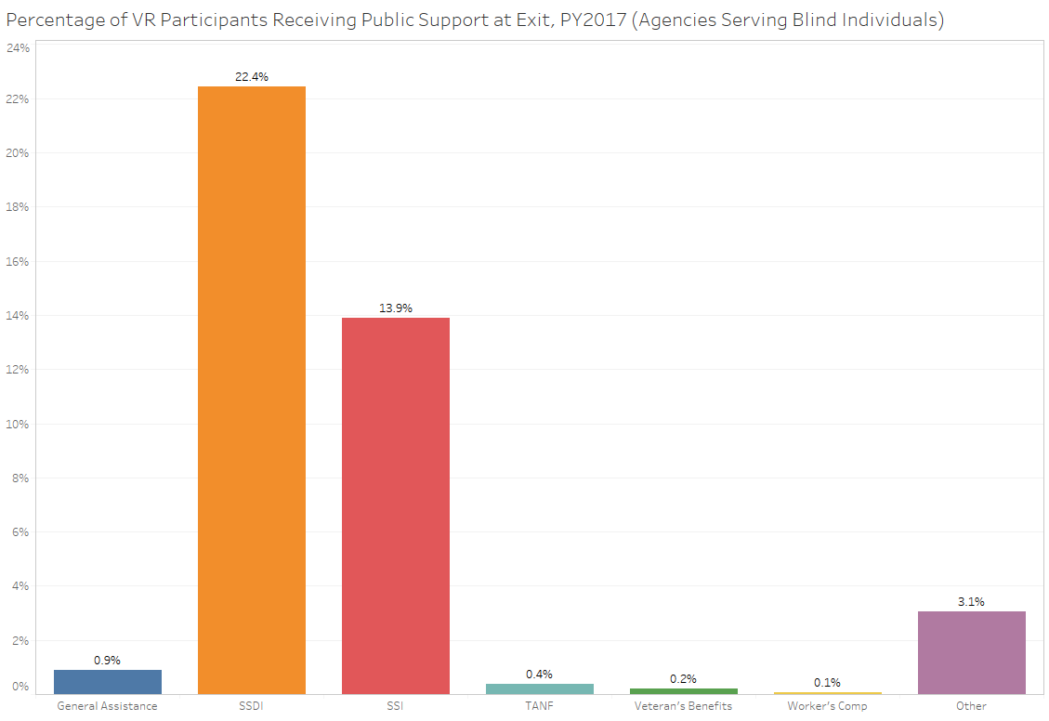
Public Support at Exit

Slide 30
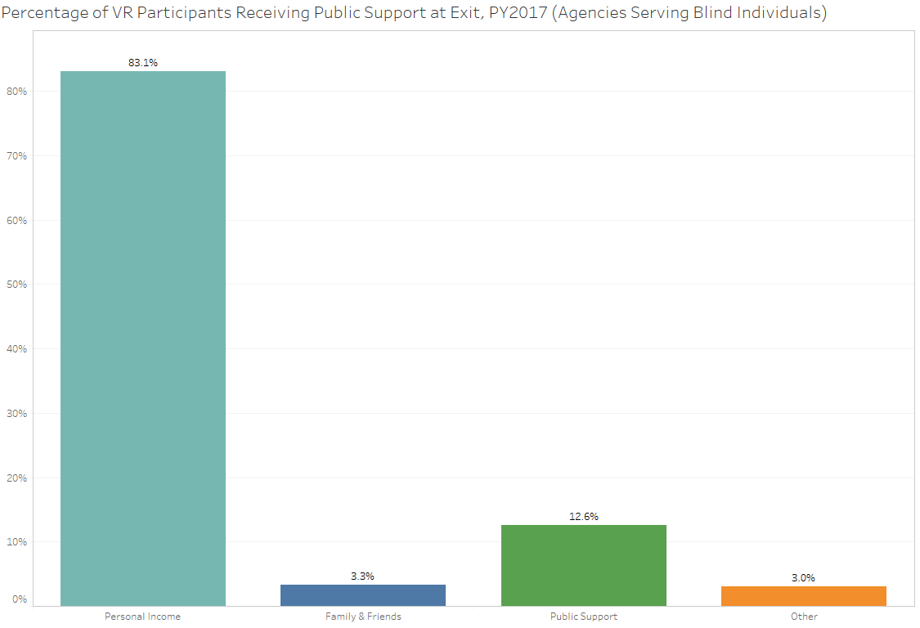
Primary Support at Exit

Slide 31
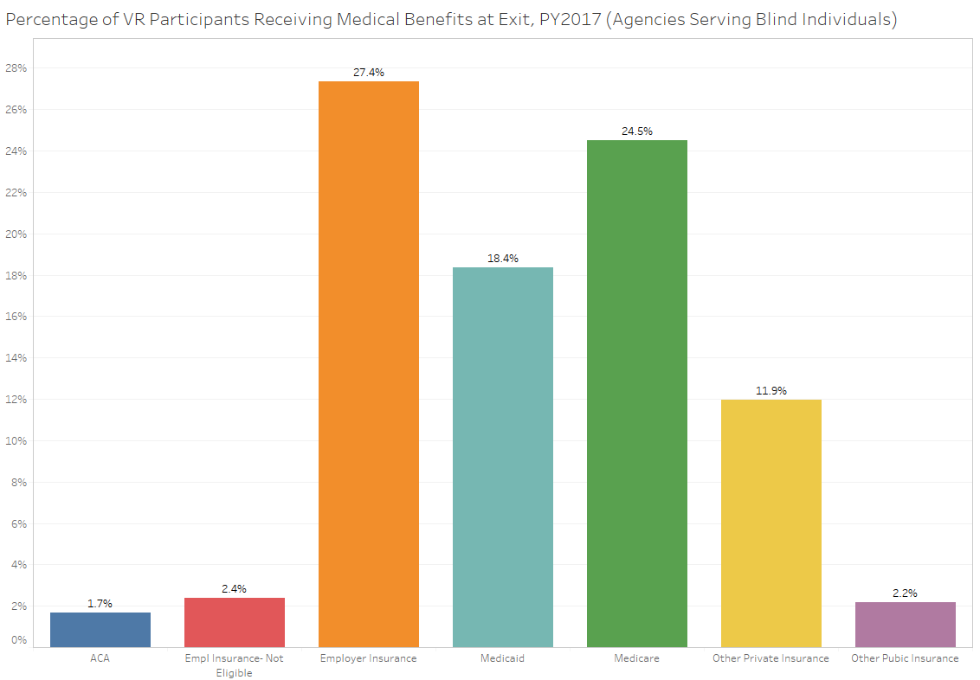
Source of Medical Benefits at Exit

Slide 32
Pre-Employment Transition Services

Slide 33
Pre-Employment Transition Services
7,629 Pre-Employment Transition Services were provided by VR agencies in PY2017
5,211 individuals received Pre-Employment Transition Services in PY2017
3,480 of these individuals were potentially eligible for VR services

Slide 34
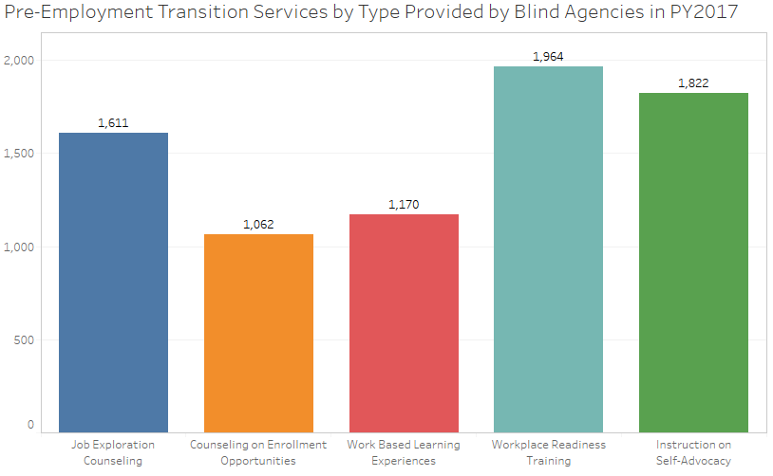
Pre-ETS

Slide 35
Internal Data and Considerations For VR Program Improvement

Slide 36
Leadership Buy-In
Belief in WIOA, working together, improving participant outcomes, etc.

Slide 37
Crossover With VR Reporting
VR Agency
SF-425
State Plan
RSA-911
RSA-113
RSA-2
Internal Reports
Title IV
(C, G, B)
Notes:
VR will not be successful with all of the new WIOA requirements if we silo reporting and processes internally. VR is responsible for many different reports. Individuals and departments in charge of these reports need to be communicating with each other, reviewing data together and partnering with program experts. VR agencies are require to submit:
VR Portion of WIOA State Plan (WIOA-VR)
Federal Financial Report (SF-425)
Client Service Record Report (RSA-911)
Resolution of Applicant/Client Appeals (RSA-722)
Independent Living Services for Older Individuals who are Blind (RSA-7-OB)
VR Program/Cost Report (RSA-2)
Cumulative Caseload Report (RSA-113)
SVRA teams need to be talking and communicating in order to understand varying implications and progress made by the agency; program managers, administrators, data/case management team, fiscal, quality assurance and trainers, etc.
Example: Pre-Employment Transition Services – Policy, fiscal, training, program, RSA-911, etc. all must work together to meet the requirements. If your fiscal report shows that you have spent your 15% reserve, is that reflected in the student data reported in the RSA-911, as well as training and policies outlined for staff to ensure accuracy?

Slide 38
Program Evaluation
Internal Controls
Training & Assessment
Policies & Procedures
Reasonable Assurance
Notes:
Example: Key components of all aspects of WIOA and reporting to provide reasonable assurance that data is valid and reliable.
Policies and procedures
Training and assessment
Internal Controls

Slide 39
Data Validation: Considerations
Do case files contain supporting documentation required in policy?
  How are you documenting start date of employment and weekly earnings in primary occupation?
  Is type of closure and reason for exit accurately described during case closure?
Case record reviews are an invaluable program improvement tool.
  Are the documentation requirements being met and case notes documented?
  Are the data being reported accurately?
Type of case record reviews
  Supervisory closure reviews
  Annual statewide case reviews vs. target case reviews
What steps have been made to fix or reconcile issues found?
Notes:
Combine with Slide 37

Slide 40
Pre-Employment Transition Services
Potentially Eligible Student
Does not apply for VR Services
Pre-ETS
IPE Goal
Outcomes
Outcome?
Notes:
VR can track what happens to a student with a disability that applies and is determined eligible for VR services. However, what happens to those students who do not apply? What is their outcome? What impact did pre-ets make? Why did they not apply (not needed due to pre-ets, unable to locate, etc.)?

Slide 41
Actual Services: Real-Time Reporting
Can VR verify …
  Funds expended on in-house services?
    Career and Training
    Quarterly and Annually
  Participant Services: During the quarter in which they happen?
    VR Counseling and Guidance
    Benefits Planning
    VR-Provided Pre-Employment Transition Services
  Other
Notes:
Example of focus areas for real time reporting.

Slide 42
Economic Self-Sufficiency
@IPE
@Exit
Training?
Credential?
Timely Services?
Skill Gains?
Wages
Hours
SOC
Primary Source of Support*
Wages
Hours
SOC
Primary Source of Support
vs
Pre-ETS?
Benefits Planning?
* At Application
Notes:
Is VR comparing data throughout the life of a case to assess the quality and gaps in services? This helps us determine impact and a larger picture of what has happened.

Slide 43
Impact of Services
Can VR verify …
  What impact VR Services made?
  Relationship of outcomes due to …
    Receipt of Pre-Employment Transition Services
    Benefits Planning or Financial Literacy
    Credential and Skill Gains
    VR Counseling and Guidance
  Other
Notes:
Examples of assessing impact of VR Services.

Slide 44
Employment Rates
Employment Rates
Labor Market Information
Capacity Building
Workforce Integration
Staff
Program Access
Economy (local/state)
Notes:
Employment rates are effected by many factors. Does VR understand those local factors and assess VR’s ability to alleviate barriers or overcome them to increase employment rates? Does VR have all the information to “tell the story” which may also benefit the negotiation for targets activity.

Slide 45
RSA-911 Reporting Best Practices
Submit early
  Time to correct errors, run reports, work with the field.
Review Quarterly
  Correct system errors, identify training needs, prevent future errors.
Internal Reviews
  Do policies, procedures and training exist to explain the data?
Compare data to RSA-911 Data Dashboards
  Are you seeing what RSA is seeing?

Slide 46
Recommendations
Agencies should develop clear guidance and policies, including written internal control policies in place to help staff learn and be consistent in these new approaches.
Pilots: Don’t forget to collect data and evaluate.
Review data regularly. (Quarterly is the minimum.)
Communicate errors with RSA ASAP in order to fix data and prevent future reporting problems.
Work together with your WIOA partners. Many aspects are dependent upon local decisions, partners and strategies.

Slide 47

Keep Doing Good Rehab!
Thank you!
Vocational
Rehabilitation

Slide 48


Contact
Melinda Giancola
(202) 245-7312
RSAData@ed.gov
Rachel Anderson
(435) 764-8487
randerson@ndi-inc.org

Slide 49
NCSAB: Proactive Methods for Using Data to Track and Improve VR Outcomes
Michigan Bureau of Services
for Blind Persons
Bill Robinson, Director
Lisa Kisiel, Field Services Division Director
Wednesday October 31, 2018
2:45-4:30pm Session 1

Slide 50
Why Data is Important?
What is measured can be managed.
Metrics
A Metric is a quantifiable measure that is used to track and assess the status of a specific business process. Examples:
60 Day Eligibility (Case Mgmt. System Dashboard)
90 Day IPE (Case Mgmt. System Dashboard)

Slide 51
Why Data is Important?
What is measured can be managed
Performance Indicator evaluates the effectiveness or success of the organization’s programs. Examples:
Employment Rate  2nd Quarter After Exit
Employment Rate  4th Quarter After Exit

Slide 52
Data Driven Planning & Management
Pre-Employment Transition Services
  Forecasting
  Collaboration with LEAs (Example included)
  Workforce Collaboration
  Staffing/Resource Allocation - (Example included)
  Case Services
    911 Data – RSA Reports (Example included)
    Data Analytics – Action Alerts, Dashboards, etc.
    Financial Data
      Grant Mgmt; Projections (OOS); DSA & Public updates

Slide 53
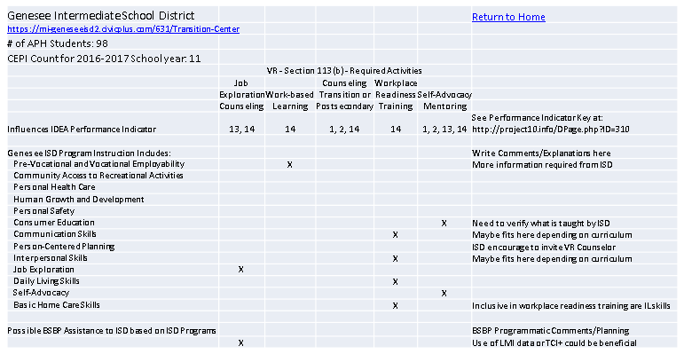
Pre-ETS Collaboration with LEAs - Strategic planning and resource development

Slide 54
Workforce Collaboration
Infrastructure Funding Agreements – “Active Participants”
Accessibility
Tracking In-Kind Contributions
Tracking In-Service
Tracking Contacts
Toolkit for Counselors

Slide 55
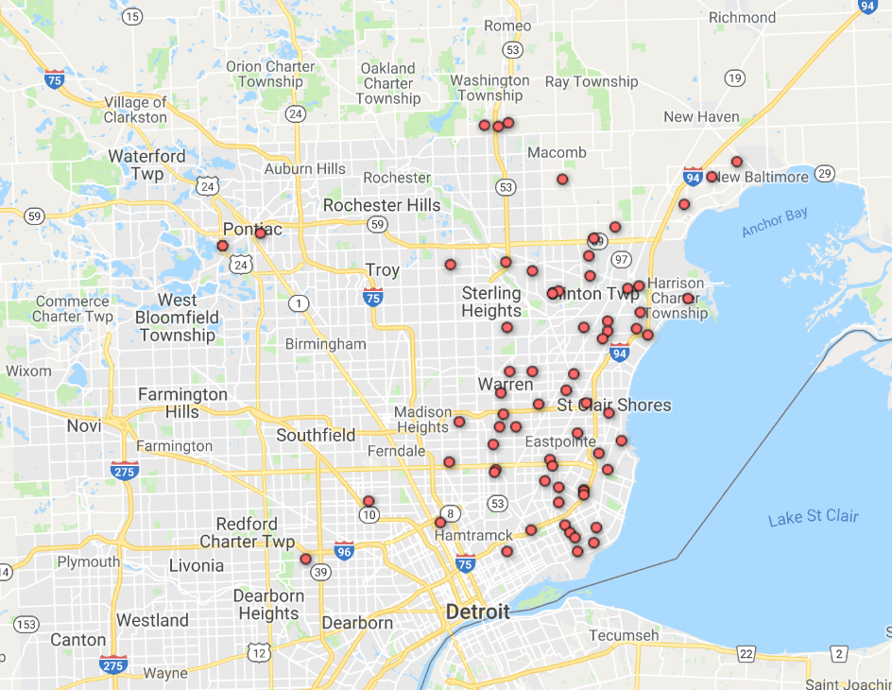
Staffing/Resource Allocation – Counselor X – No. of Clients – 68

Slide 56
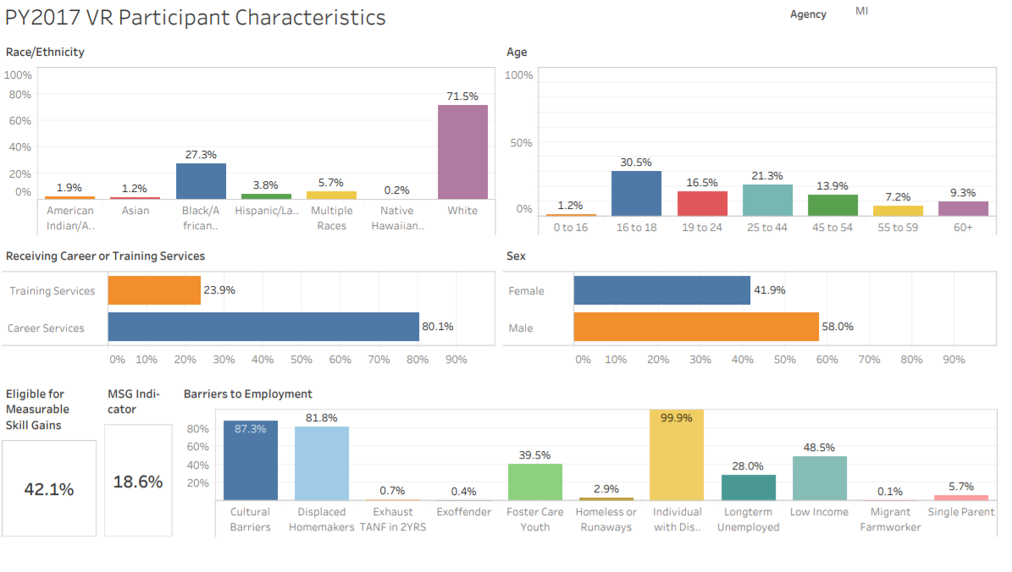
PY2017 VR Participant Characteristics

Slide 57

WIOA PERFORMANCE DRIVEN!
Video sound is only of vehicles racing.
Notes:
Slide is not 508 Compliant

Slide 58
LARA/BSBP – 2018 NCSAB FALL CONFERENCE
Thank you!
Questions?
Contact information:
RobinsonW7@Michigan.gov
kisiell@michigan.gov
The Vocational Rehabilitation programs described in this PowerPoint are funded 78.7% through a VR grant from the U.S. Department of Education and 21.3% through State funding. Total Federal funding for Federal Fiscal Year 2018 was approximately $16,630,804.

Slide 59

And the Data Says….
NCSAB Presentation –
Leading A Client Outcome Driven Agency
Notes:
Slide is not 508 Compliant

Slide 60
Principles of Outcome Based Management System:
  Based on Lean Principles of management
  All work is made up of processes
  Each process has a customer(s)
  99% of performance issues are related to a breakdown of the process, not the people involved
  If you want to improve the process, the solution lies with those who are closest to the work
  You can’t improve everything all at once, so you should target improvements where they are most needed
Notes:
Slide is not 508 Compliant

Slide 61




Overview of the Four Elements of Outcome Based Management
1
3
Fundamentals Map
Quarterly Target Review (QTR)
2
4
Processes, Measures and Scorecard
Problem-Solving
Notes:
Slide is not 508 Compliant

Slide 62
The Fundamentals Map
The important ‘core work’ of the Commission
Identified the client facing work processes
Identified the supporting work processes
Created the major Outcomes Measures that are essential to our success.

Slide 63
The Scorecard
Define the process ‘Primary’ Customers :
  Who receives the output of this process
  Can be internal or external
What are their needs?
  What is most important to them
How will we know if we’re meeting their needs?
  What must we measure to know if needs are being met?

Slide 64
Monthly Measure & Quarterly Target Reviews
Objectives
  Each of the teams conduct monthly reviews of their measures
  The measures roll up to agency wide measures reviewed quarterly
  Understand our performance based on data
  Compare results to targets
  Opportunity to recognize progress
  Provides transparency to improvement needs
  It’s OK to have measures in Red/Yellow – tells us where we need to focus

Slide 65
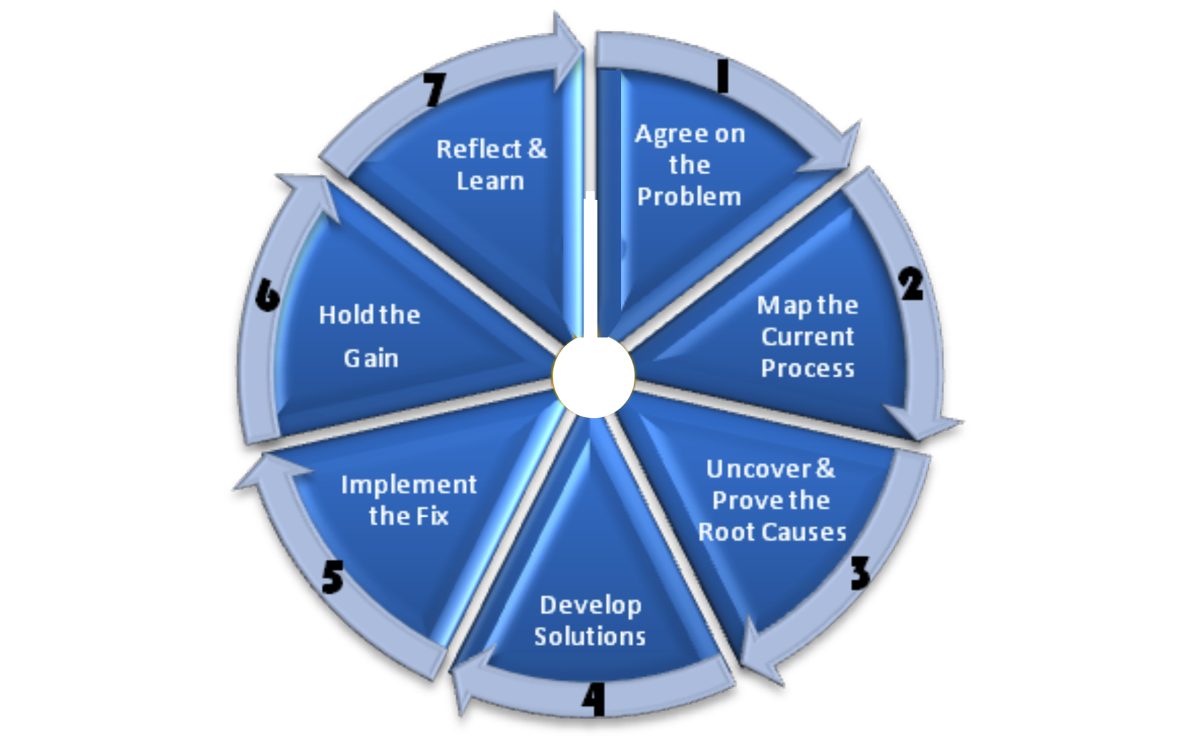
Performance Improvement: 7-Step Problem Solving
Systematically
improving our processes
using common
problem-solving toolset

Slide 66

Examples of Performance Improvements
1
Time from application to eligibility in the Vocational Rehabilitation Program last quarter was 30.3 days, 49.5 % below the 60 days allowed by federal law.
2
Time from eligibility to plan development was 55 days last quarter, 38.9% below the 90 days allowed by federal law.
Reduced wait time from referral to initial visit in Older Blind Independent Living Program from (9) weeks average in July 2015 to (2.1) weeks in February 2017 representing a 76.7% decrease in wait time.
3
Notes:
Slide is not 508 Compliant

Slide 67
Thank you.

Slide 69
WIOA Pre-ETS Students: What are their needs?
Coleen Wunderlich
Hadley Institute for the Blind
and Visually Impaired

Slide 70
What we were trying to find out
What do youth need?
How interested are the potential participants?
What would be helpful to VR agencies, if Hadley made a program?

Slide 71
Our 5 questions (1-3)
1. Would you distribute the link and encourage your staff to participate?
2. What requirements would our program have to fulfill for you to spend WIOA dollars on it?
3. Less than 10 percent of blind youth have closed cases. Where are the others? How are those who receive services different from those who do not?

Slide 72
Our 5 questions (4-5)
4. 40% of youth with closed cases in 2014 had additional disabilities. We would target BVI who are strong technology users, proficient in English, and without cognitive disabilities. What is your reaction to this plan?
5. College bound or vocational track?

Slide 73
Three themes that emerged
Agencies encounter barriers to enrollment
Youth have a large variety of needs
It’s important to promote the program well
Notes:
Slide is not 508 Compliant

Slide 74
Three themes—Barriers
Mislabeling by school districts
Parents and professionals don’t understand
Takes time to be known and to recruit
Notes:
Slide is not 508 Compliant

Slide 75
Three themes— Program Needs
Career and Independent Living Skills
Using available resources—HS & college
Advocacy and self-determination
Financial and Social Skills
Braille and Orientation & Mobility
Notes:
Slide is not 508 Compliant

Slide 76
Three themes—Promotion
Make it fun
Meet agency needs for X disabilities & rural
Package it well for advertising
Notes:
Slide is not 508 Compliant

Slide 77
Students with Additional Disabilities
Work with disability agencies and groups
Provide additional tech support for students
Provide extra instructional support for instructors
Include youth with autism
Some will have no other VR opportunity, other than pre-ETS
Notes:
Slide is not 508 Compliant

Slide 78
Other Special Populations
Sensitive Populations
Rural Students and Families
Needs of Parents
Notes:
Slide is not 508 Compliant

Slide 79
Notes:
Slide is not 508 Compliant

