Slide 1
Accessibility Is A Part of Our Mission Statement

Slide 2
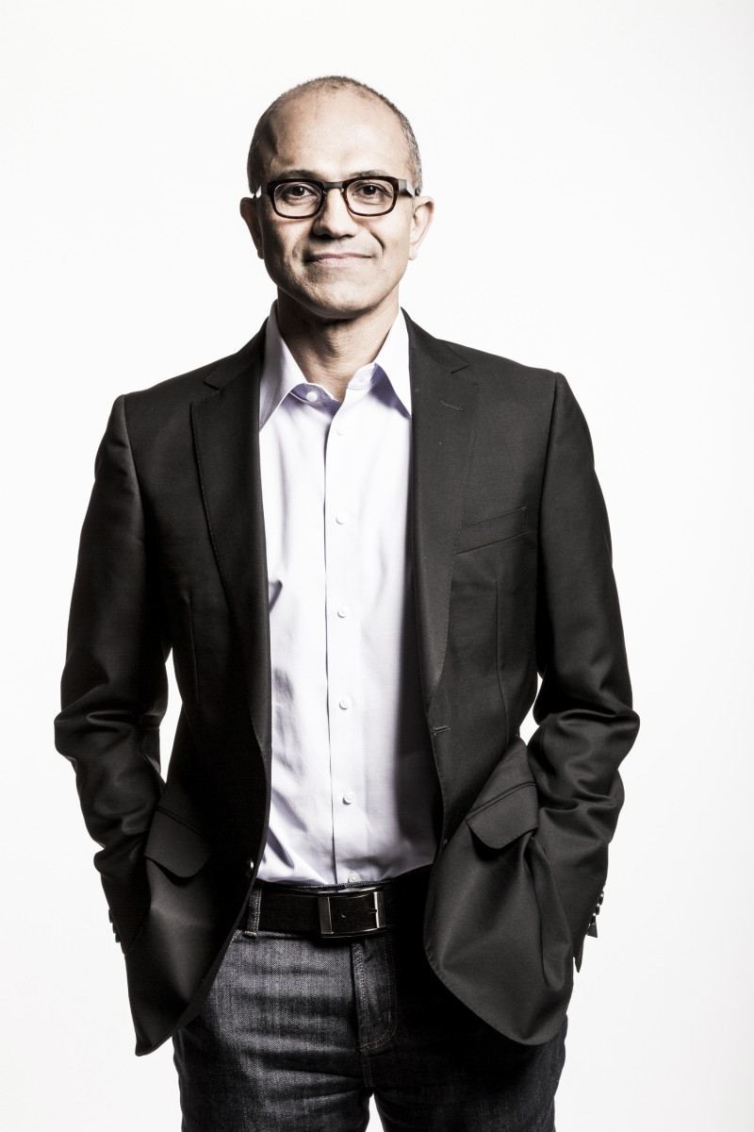
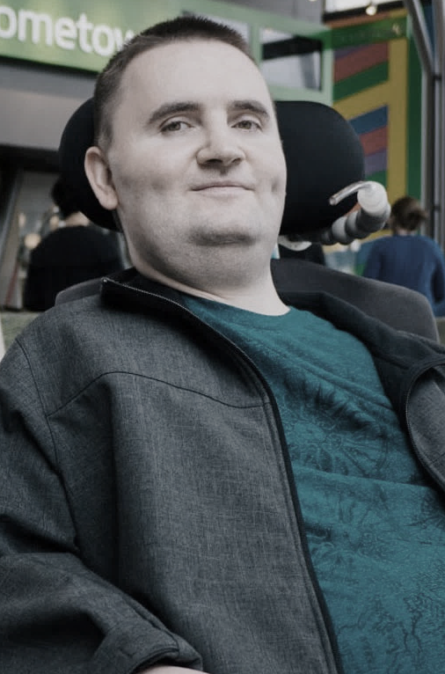
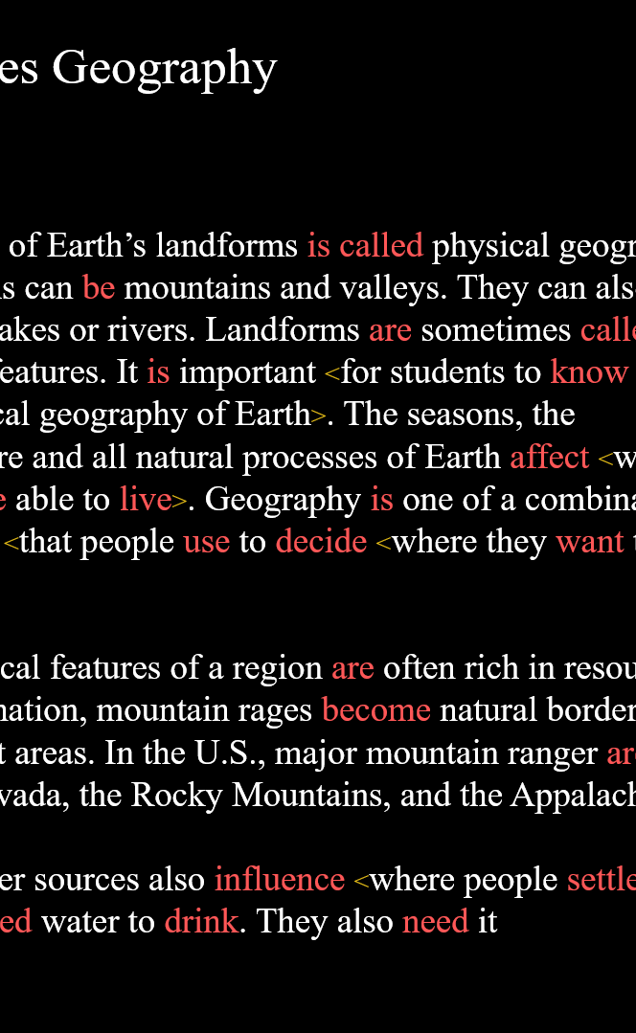
Inclusive Culture at Microsoft come from both the top down with support from senior leadership and bottom up our employees
“We will focus on designing and building products that our customers
love and that are accessible to everyone and built for each of us.”
- Satya Nadella, CEO, Microsoft
Senior Leadership
Employees are the Experts
Hackathons
Notes:
Accessibility at Microsoft is supported from both the top down and bottom up. We SLT support from leaders in our company and our CEO recently said “we will focus on designing and building products our customers love and that are accessible to everyone and built for each of us. We have bottom up support by creating a culture of inclusion through our inclusive hiring with people with disabilities on teams as the experts in our company. We see these efforts come to fruition in our hackathon culture. Every year we have /oneweek where employees from across the company come together to hack on new ideas. Three years ago we have 10 ability hacks that looked to solve some of the hardest problems in disability – last year we had 102. Projects such as Learning Tools for OneNote are a result. New functionality to help people with dyslexia read better. It is now in Word.

Slide 3
In it for the long game
From accessibility to inclusion
1990
2000
2010
2020
Notes:
Microsoft is no stranger to this effort. We have a rich history in this space and have been helping contribute to — and lead — the advancement of accessible technology for decades.
Early 90’s
We created keyboard shortcuts and Sticky Keys designed to support mobility limitations.
Microsoft Research was founded- its early work focused speech. We believed speech would be the next frontier to creating natural computing. This led to intelligent technology and the ability of a computer to recognize speech with an error rate of just 5.9. That’s about as well as a person does. This capability really shines in products like Skype Translator, which provides a channel for real time communication for people with hearing impairments or across language barriers.
1997 Bill Gates declared our commitment to accessibility.
2002 Our Disability Employee Resource group began. It has since expanded into 15 groups.
2012 We launched our Disability Answer Desk, now available in multiple countries and languages including ASL.
Lessons
Our road, however, has not been without setbacks and lessons. A few years back we received feedback from the people who are the most important to us — our employees, our customers and our partners — that we weren’t meeting their needs; that at times we were contributing to exclusion through our technology.
We listened. We learned. We worked harder.
We have put in place systems like the Windows Insider Program, where millions of people are helping us design Windows with their feedback. We proactively seek input early and often in our design process and work iteratively so that we can adjust as we learn more. We partner closely with advocacy groups and are pleased that organizations like the American Council for the Blind use Office 365 internally and advocate publicly about the accessibility of Microsoft products such as Microsoft Teams.

Slide 4

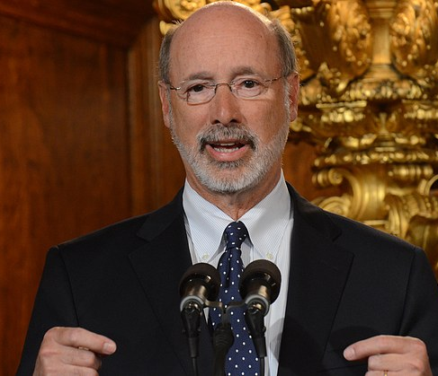
Commonwealth of Pennsylvania
Partnership
Worked with Joe Strechay BBVS
OVR was struggling for visibility
Created State Policy
When the Governor backed it everyone else backed it
Got me out of talking with IT
“The administration announced that Pennsylvania is the first state government to partner with Microsoft Corporation to provide training and other resources on accessibility to employees” May 20, 2018 press release
https://www.governor.pa.gov/wolf-administration-welcomes-20-students-disabilities-summer-internship-program/
Notes:
Ryan and Jeff Hicks, any I discovered this was something on elected officials' minds. In my case I saw accessibility as something he challenged the State to do in his monthly news letter. I called his press office and asked who is responsible for doing that and got a name. Bing, Linked In sales or as in my case call and ask, but find the owner of accessibility and that person has the ear of the mayor or governor
Which leads into the second part.
Making technology accessible to everyone in the community is a priority for local governments, which are often bound by regulations mandating a focus on inclusion.
Engage as One Microsoft: Bring the right Microsoft experts to critical conversations, including account and product teams. To discuss accessibility, leverage the expertise of the Corporate, External, & Legal Affairs group (CELA), which can help develop messaging that resonates with various stake holders.
Help IT engage with business: Arm the CIO with insight into accessibility capabilities. This empowers IT to educate BDMs on what they already own and how IT can help business
solve accessibility issues.
Bringing both sides of the house together is more effective than going straight to business decision makers, and cutting IT out of the process.
July 2018

Slide 5

State of California
Partnership
Accessibility is a priority for California government
Accessibility ensures that all citizens have equal access to services and information
Mandatory compliance by July 1, 2019 under California Government Code Section 11546.7
Covers both website and published document accessibility
California has established a center of excellence and training for public facing content creators
Without digital accessibility, millions of Californians experience barriers when using the internet to search for services, file forms or access content on state government websites.
http://www.dor.ca.gov/State-AB434/index.html
Notes:
Ryan and Jeff Hicks, any I discovered this was something on elected officials' minds. In my case I saw accessibility as something he challenged the State to do in his monthly news letter. I called his press office and asked who is responsible for doing that and got a name. Bing, Linked In sales or as in my case call and ask, but find the owner of accessibility and that person has the ear of the mayor or governor
Which leads into the second part.
Making technology accessible to everyone in the community is a priority for local governments, which are often bound by regulations mandating a focus on inclusion.
Engage as One Microsoft: Bring the right Microsoft experts to critical conversations, including account and product teams. To discuss accessibility, leverage the expertise of the Corporate, External, & Legal Affairs group (CELA), which can help develop messaging that resonates with various stake holders.
Help IT engage with business: Arm the CIO with insight into accessibility capabilities. This empowers IT to educate BDMs on what they already own and how IT can help business
solve accessibility issues.
Bringing both sides of the house together is more effective than going straight to business decision makers, and cutting IT out of the process.
July 2018

Slide 6






Creating Accessible Content in Word
IMAGES
TABLES AND CHARTS
HEADINGS
LINKS
LISTS
ACCESSIBILITY CHECKER

Slide 7
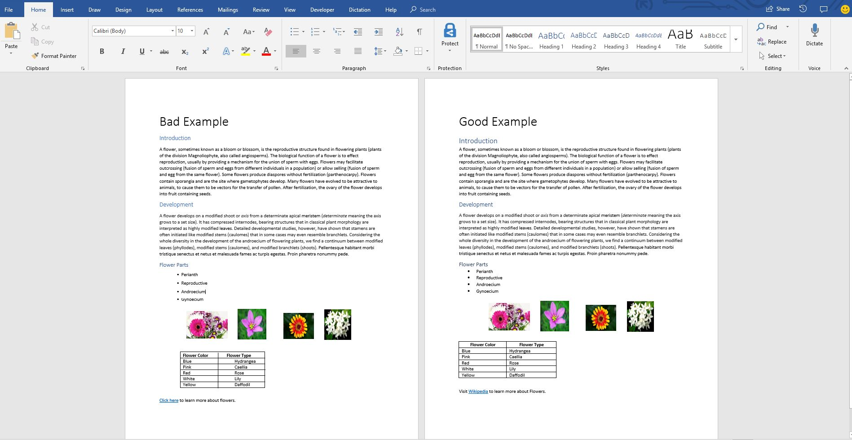
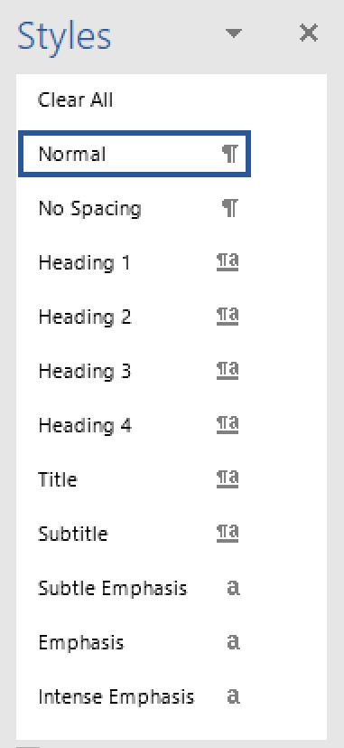
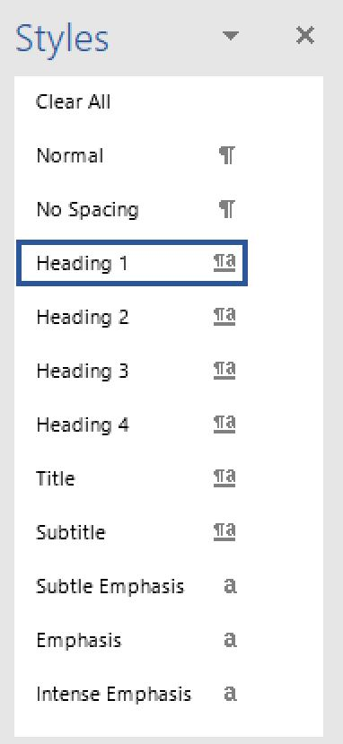
HEADINGS
Notes:
Placeholder

Slide 8

Notes:
Accessibility checker in Word (me)
Outlook does dictation (vous)
Windows dictation
Phone seeing AI
Edge reader capabilities

Slide 9
Offering
Helpdesk integration
Training Material
Improved Solutions (twice a year)
Learning events about accessibility 1 to many

Slide 10
Reinforcement (Next Steps)
Worldwide Accessibility Community Site: https://microsoft.sharepoint.com/teams/wwcaccessibility
Overview of Microsoft Office Accessibility: www.microsoft.com/Accessibility/Office
Support Articles for Productivity and Inclusion with Office 365: aka.ms/OfficeAccessibility
Short Demonstrations of Office 365 Accessibility Capabilities: aka.ms/MicrosoftMechanicsAccessibility
Blogs on Office 365 Accessibility and What’s New in Office: aka.ms/A11YinO365 and aka.ms/WhatsNewInOffice
  Microsoft Trust Center and Conformance Documents informed by Trusted Tester Process:
    https://www.microsoft.com/en-us/trustcenter/compliance/accessibility
    aka.ms/EN301549, aka.ms/508VPATs and aka.ms/WCAG2.0
  Enterprise Disability Answer Desk for Help with Accessibility Issues: aka.ms/Edad
Global Accessibility Awareness Day
Sway on Accessibility

Slide 11

Q&A

