Slide 1

Engaging Teens and Young Adults Through Pre-ETS in Randolph-Sheppard
Notes:
KM Notes – strength of BEP/Transition partnership evidenced by photo
-In Vermont, we are small but mighty. We have two cafeterias and two Operators. Photo above is from our Innovation Café in Burlington.
-Is it worth it? Yes! Review folks in the photo. Describe their relation to both BEP and transition programs.
-HIGHLY effective recruitment tool for Operators

Slide 2

What we hope you leave with
Knowledge of Pre-ETS and its flexibility
Knowledge of the Teenager(!)
Ways BEP and Pre-ETS can unite
Next steps for your state

Slide 3
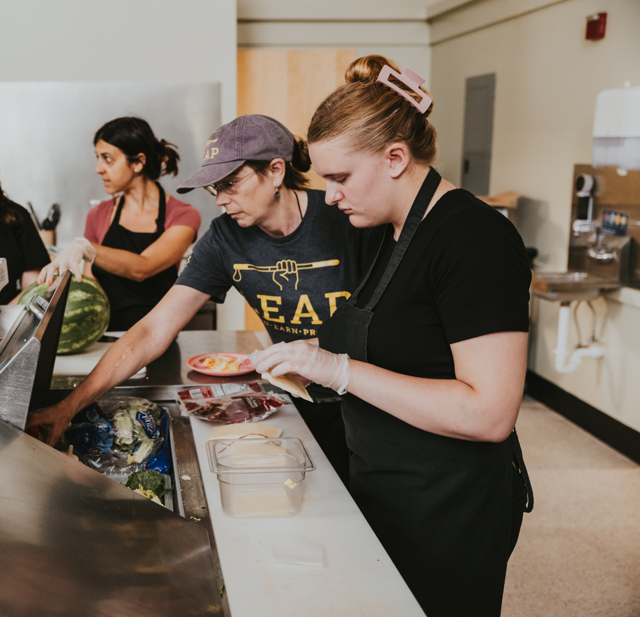
Strengthen the Partnership
Get your BEP and Pre-ETS experts in the same planning room
NTACTC: https://transitionta.org/topics/pre-ets/
Operator buy in
Remain flexible and adaptable
Notes:
Quickly review how to access Pre-ETS regulations through NTACTC – reach out to them if you have questions
You’ll need your BEP and Pre-ETS experts to work closely together. You’ll need to ensure your program meets regulations on both sides of the aisle – BEP and Pre-ETS.
Ensure Operator interest and buy in at every step of the way

Slide 4

Engaging Teenagers and Young Adults
The Teenage Brain
What do teens want?
Remain flexible and adaptable
Try Try Again
Notes:
Remember being a teenager activity?

Slide 5


Introducing Lindsey and Meagan

Slide 6

Thank You! Any Questions?

